Slide 1

the
workshop

Slide 2
GRAPH WRITING
Paragraph 1: Introduction_paraphrase the question.
Paragraph 2: Write the overview. (no data)
Paragraph 3+4: Describe the graph in detail. (with data)
Paragraphing notes:
1-line spacing between every 2 paragraphs.
Full stop at every paragraph’s end.
No 1st line indentation.

Slide 3
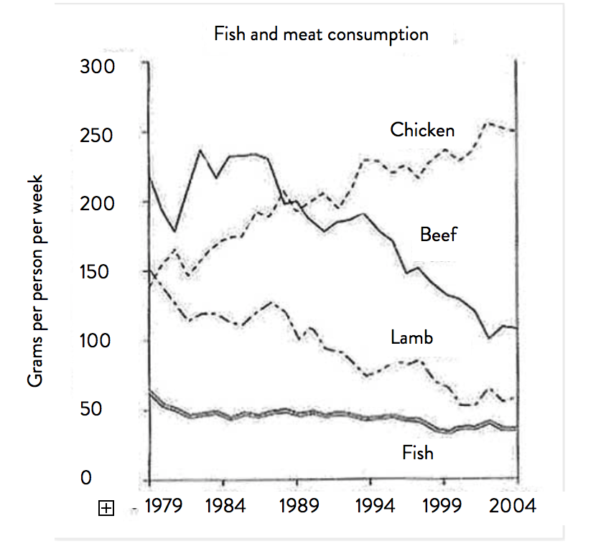
Question: “The graph below shows the consumption of fish and some different kinds of meat in a European country between 1979 and 2004”
Summarize the information by selecting and reporting the main features, and make comparisons where relevant.

Slide 4
PARAGRAPH 1: INTRODUCTION
Step 1: Paraphrase the following sentence (3 ways):
“The graph below shows the consumption of fish and some different kinds of meat in a European country between 1979 and 2004”
The graph = the given chart/line graph (no “following”/“below”/“this”).
Watch out: the number of graphs (the graph illustrates – the graphs illustrate)
Show = illustrate/depict/provide data/information on-about/compare.
Watch out: verb tense
Between 1979 and 2004 = from 1979 to 2004 = over a 25-year period beginning from 1979 = over a course of 25 years starting from 1979.
(MUST PARAPHRASE => score)
The consumption of … = (GRA) the amount of … which were eaten.
(VOCAB) the intake of … (reference only)
Kinds of meat = (VOCAB) meat products vs types/categories (ref only).
Country = nation in Europe (reference only).

Slide 5
PARAGRAPH 1: INTRODUCTION
Step 1: Paraphrase the following sentence:
“The graph below shows the consumption of fish and some different kinds of meat in a European country between 1979 and 2004”
The given line graph illustrates the amount of fish and three other meat categories (which were) consumed in a European nation over a 25-year period (which begins) beginning from 1979.
=> Specify (how many categories, measurements)
=> What graphs depict – present simple

Slide 6
Paraphrase practice
consumer spending on five different products
= consumer budget (for) | the spending patterns (of)
= five different items | commodities
The amount of money which consumers spent on five items (GRA)
The spending patterns of five different commodities (VOCAB)
car ownership in Britain from 1971 to 2007
The number of cars owned in Britain over a period of 36 years… (GRA)
changes in the cost of renting a home between 2009 and 2019
How the cost of renting a home shifted between 2009 and 2019 (GRA)
Shifts in house rentals over a 10-year period… (VOCAB)
Notes:
The number of cars (which were) owned in Britain …
Vì nếu tách ra: the number of cars was owned => sai vì the number of không “owned” được

Slide 7
Step 2: Understanding the graph
Look at the graph and answer the following questions:
1. What information does each axis show?
2. What do the four lines represent?
3. What tense do you need to use to describe this information?
4. What main features does the graph illustrate?
Consumption’s change (TREND – năm đầu và năm cuối)
Most vs least commonly- consumed product. (ORDER – cao nhất/thấp nhất)
Notes:
Dynamic - Tập trung vào 2 thứ: trend và order (trend bài này là gì; order là gì?)

Slide 8
Exercise 2: Ways to describe the order by comparison
“(1979) Consumers ate 200 grams of beef, 150 grams of chicken, 150 grams of lamb and 50 grams of fish per week”
1. So sánh nhất (Most-least)
***Beef’s consumption was the highest. vs the lowest (number).
***Beef registered the highest consumption [registered + ranking].
Beef was eaten most; fish was consumed least.(adv-no “the”).
Beef was the most commonly-consumed meat category. (the adj+n).
2. So sánh hơn (More-less)
(no data): Beef was eaten more than fish.
The consumption of beef was higher than that of fish.
(with data): Beef was consumed 150 grams more than fish.
Beef was consumed four times more than/as much as fish.
So sánh nhất với fish.
So sánh hơn – beef vs chicken & lamb.
Notes:
Fish registered the lowest …
Beef was eaten 50 grams more than / the consumption of was ... Higher than that for/the number for … those for….

Slide 9
PARAGRAPH 2
“Reporting the main features, and make comparisons”
Step 3: write the overview
Comment on trend + (order).
As can be seen from the chart, there was a downward trend in the figures for beef and lamb, while the amount of chicken (which was) eaten experienced a significant growth. In addition, fish was the least commonly-consumed product over the timescale.
Câu 1: Trend (1-2 trend nổi bật)
Câu 2: Order (loại cao nhất/thấp nhất)
Note: overview nên không report data
Notes:
How to use: “the number for”
***Phân biệt với: “the number of”
The number of + N(plural): có bao nhiêu cái gì.
e.g: the number of chickens
- The number/figure/data/statistics for + tên loại / N (ít): số liệu (data) của loại là bao nhiêu
e.g: the amount of chicken consumed was … = the number FOR chicken was …

Slide 10
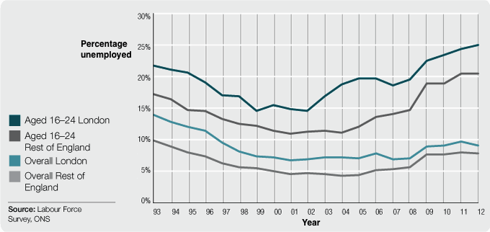
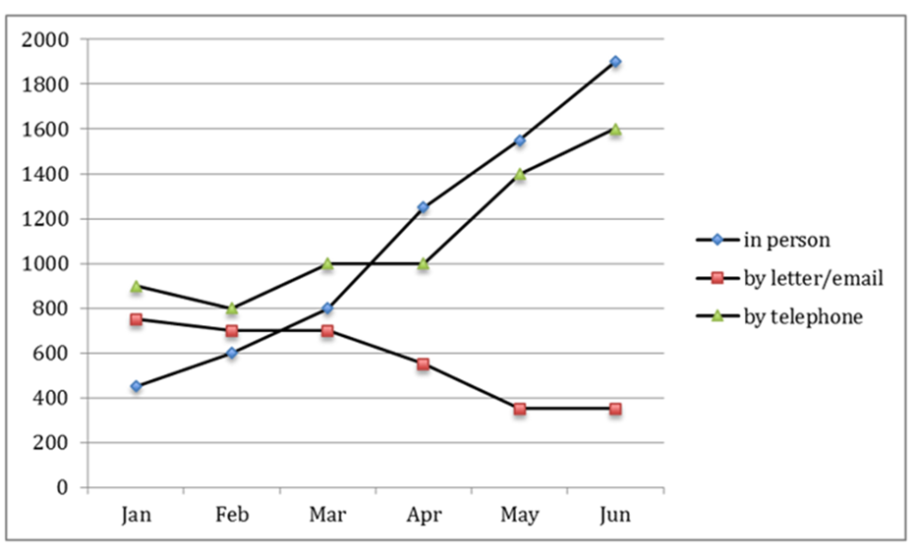
Question: The graph below shows the changes in young adult
unemployment rates in England between 1993 and 2012.
Question: The graph below shows the number of enquiries received by the Tourist
Information Office in one city over a six-month period in 2011
Trend: Rate for young adults - England - upward trend, that for the whole population declined
Order: Highest unemployment rate – young adults in London
Trend: the period witnessed a noticeable climb in the numbers for telephone calls and meetings, while that for letter/email fell.

